Slide 1
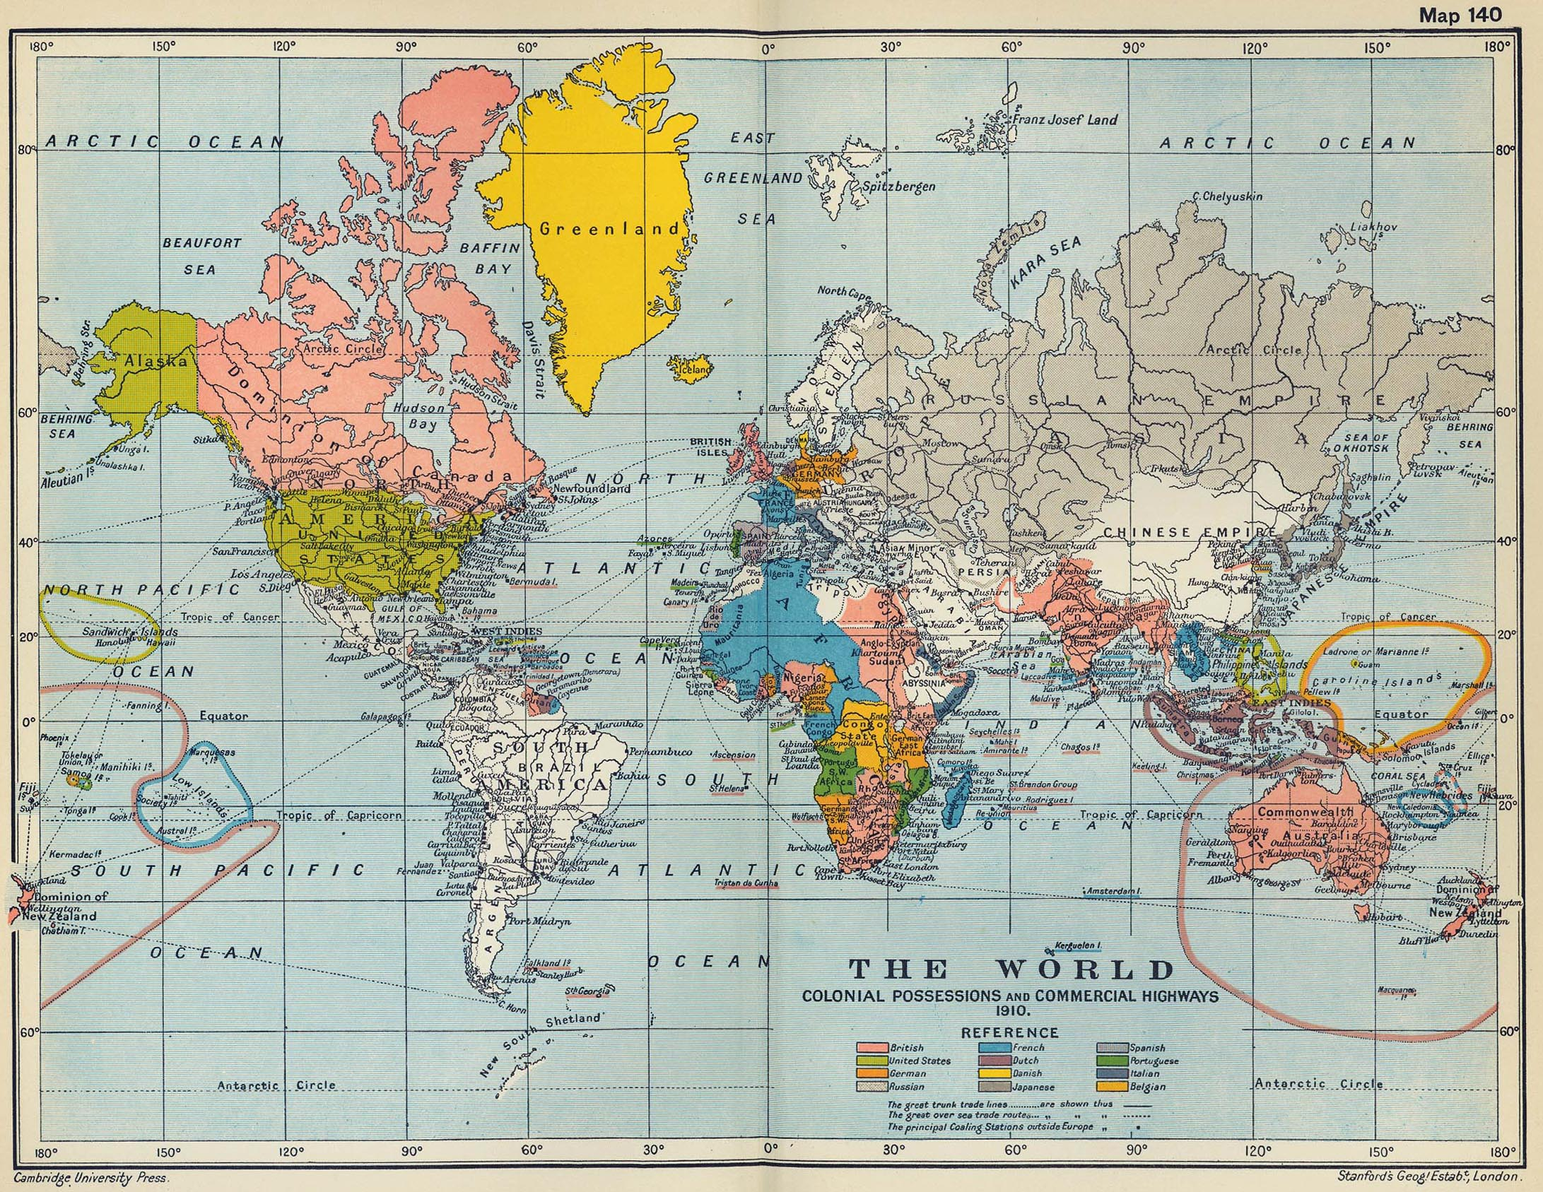
03 Geopolitics and Diplomacy
Japan During WWII
HISTR 365
Joel Legassie
Stanford’s Geographical Establishment, “The World: Colonial Possessions and Commercial Highways 1910,” 1911.

Slide 2
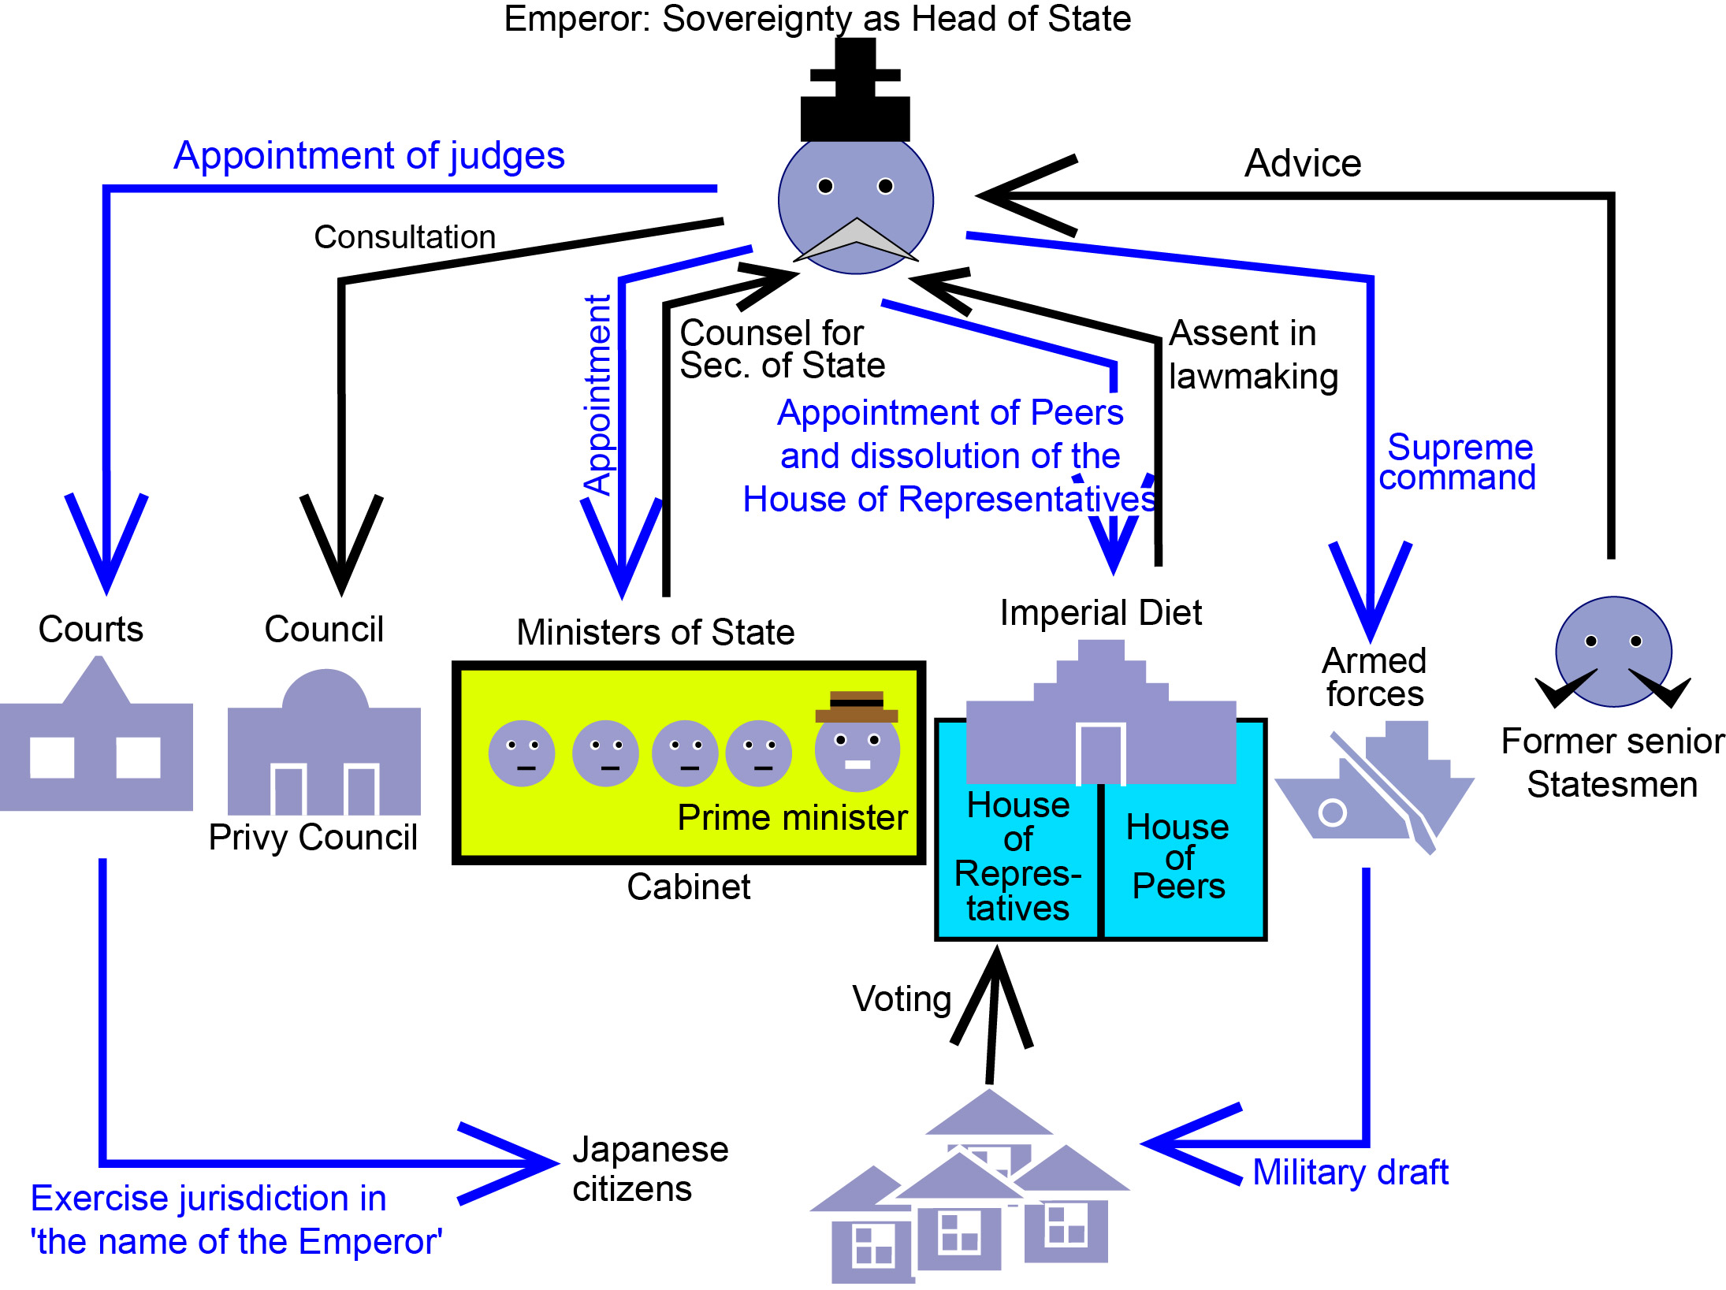
“The Organization of the Japanese Government under the Meiji Constitution.” Creative Commons Attribution-Share Alike 3.0 Unported

Slide 3
Timeline
1648 Peace of Westphalia
1857 Indian Rebellion
1858 Ansei Treaties (Unequal Treaties)
1876 Japan-Korea Treaty
1895 Treaty of Shimonoseki
1902 Anglo-Japanese Treaty
1905 Treaty of Portsmouth
1910 Annexation of Korea
1915 Twenty-one Demands
1919 Versailles Peace Conference
1922 Washington Naval Treaty
1930 London Naval Treaty
1933 Japan withdraws from League of Nations

Slide 4
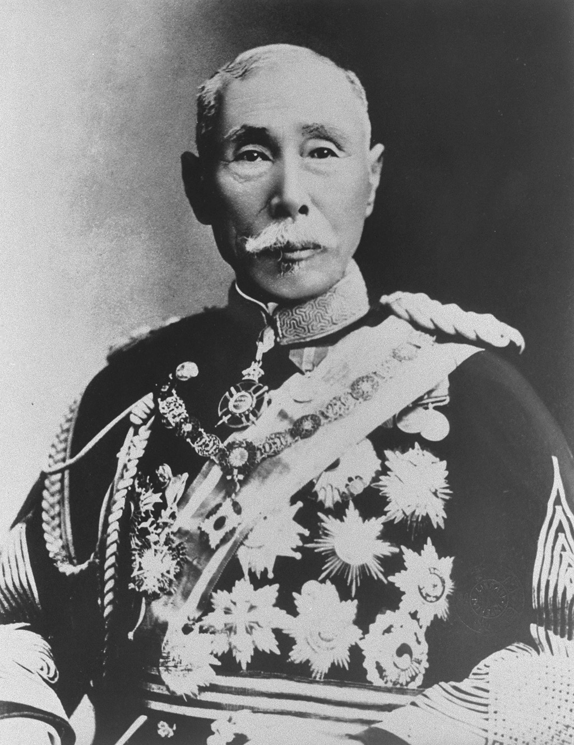
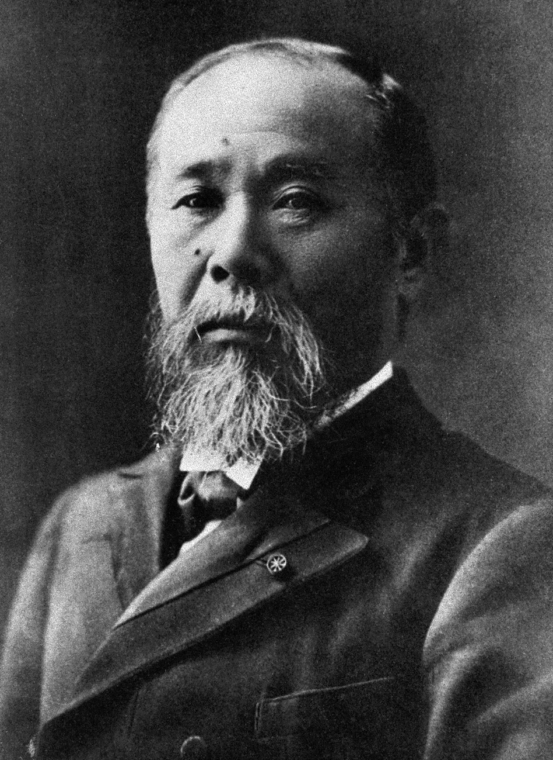
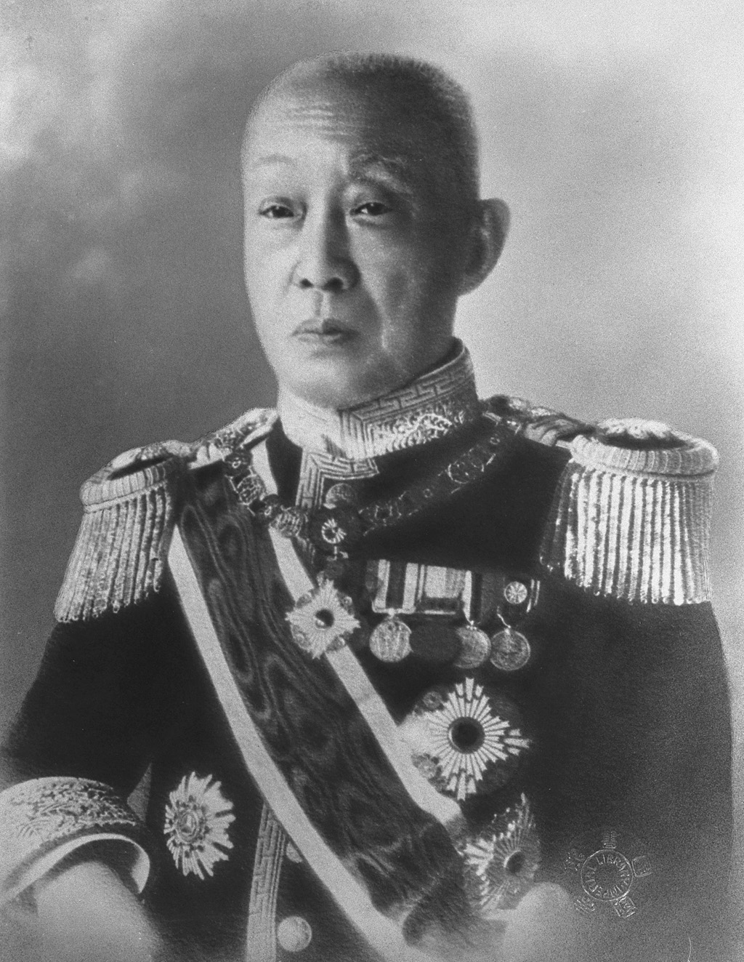
元老
Genrō
Name Dates
Itō Hirobumi 1841-1909
Kuroda Kiyotaka 1840-1900
Ōyama Iwao 1842-1916
Inoue Kaoru 1836-1915
Saigō Tsugumichi 1843-1902
Matsukata Masayoshi 1835-1924
Yamagata Aritomo 1838-1922
Katsura Tarō 1848-1913
Saionji Kinmochi 1849-1940
4“Portrait of Yamagata Aritomo 1838-1922,”Kinsei meishi shashin, 1935.
4“Portrait of Ito Hirobumi” in Rekidai Shusho tou Shashin, 1935.
4“Portrait of Saionji Kinmochi,” in Kinsei Meishi Shashin, 1934.

Slide 5
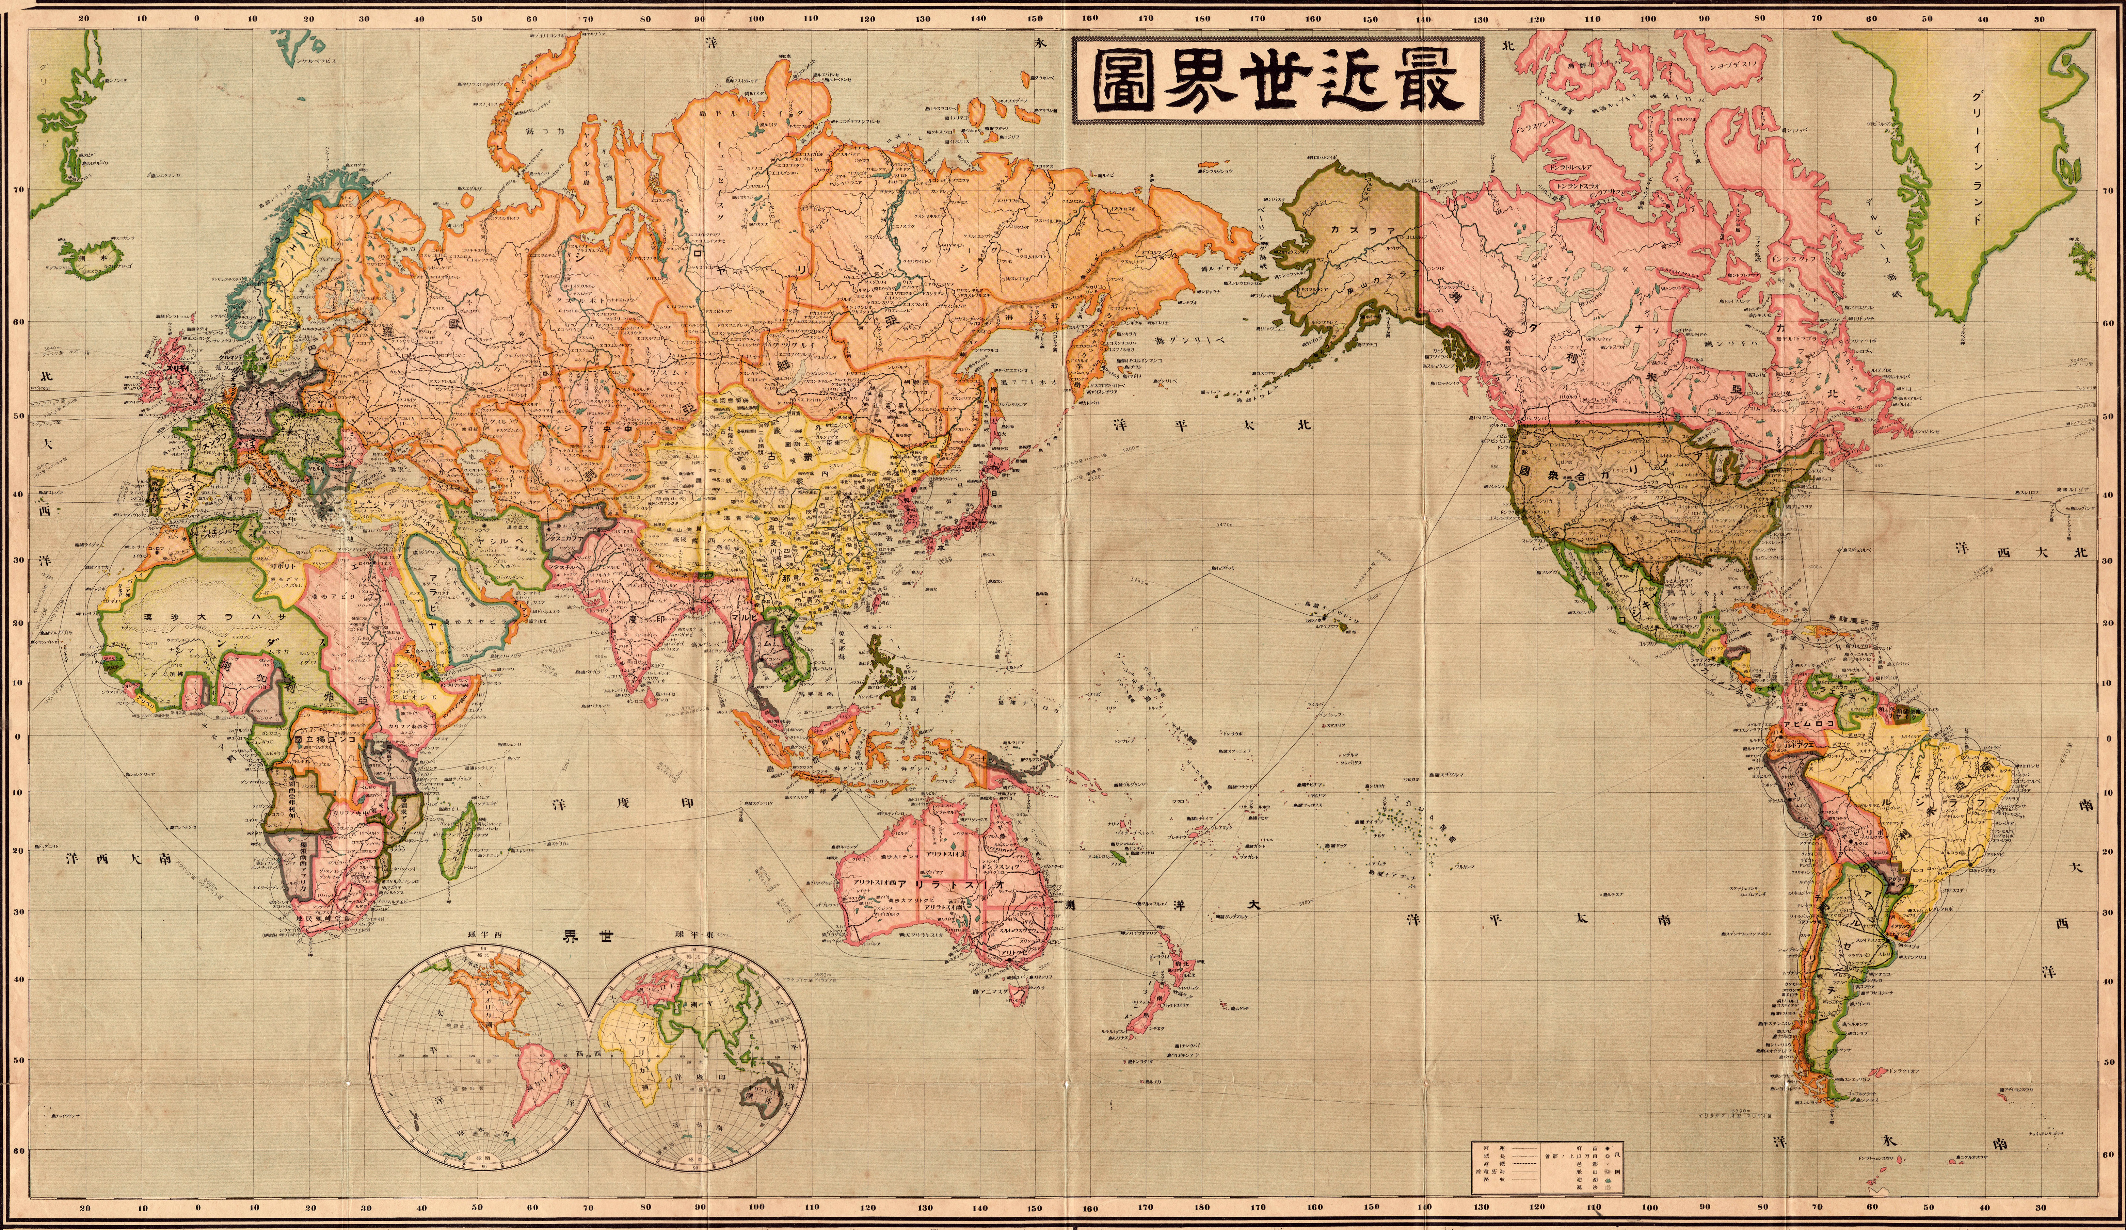
5“Japanese World Map,” 1914

Slide 6
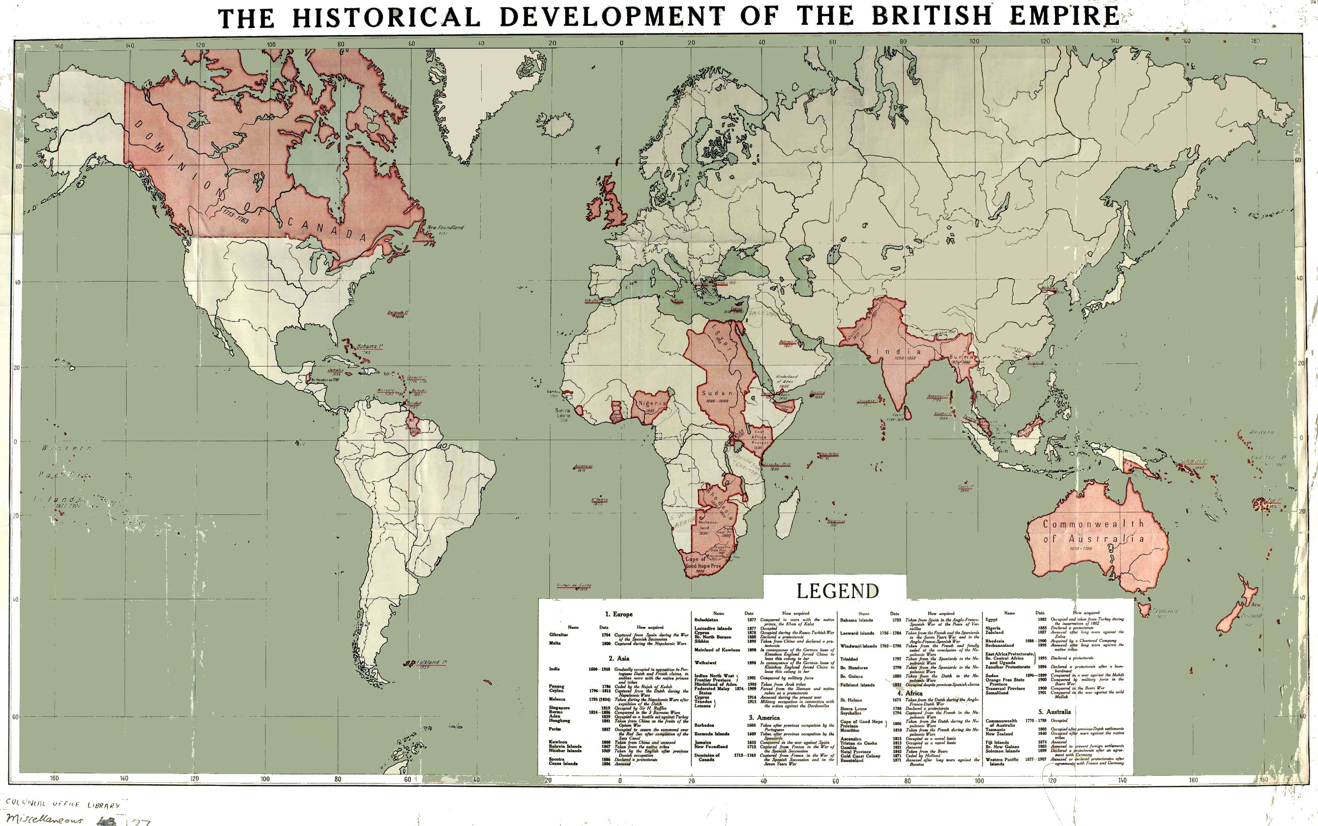
英
United Kingdom
5“The Historical Development of the British Empire,” Dietrich Reimer, Berlin 1915.

Slide 7
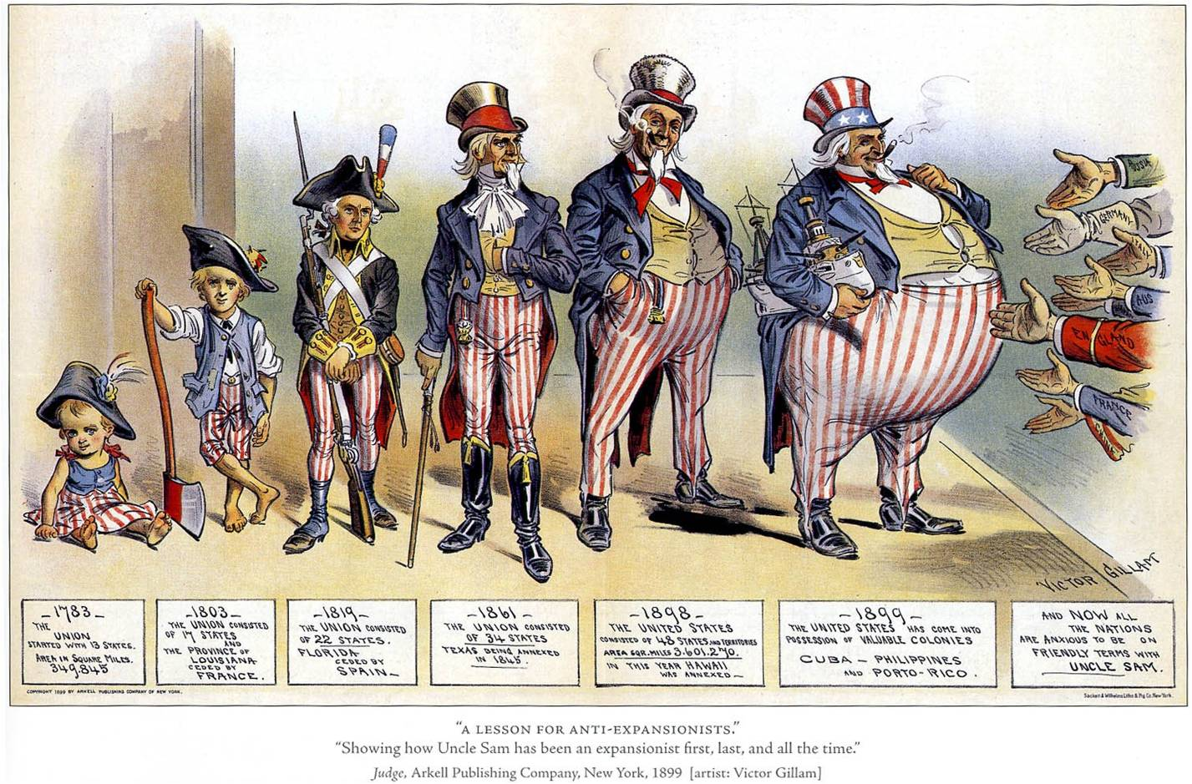
米
United States
5Victor Gillam, “A Lession for Anti-Expansionists,” Arkell Publishing Company: New York, 1899.

Slide 8
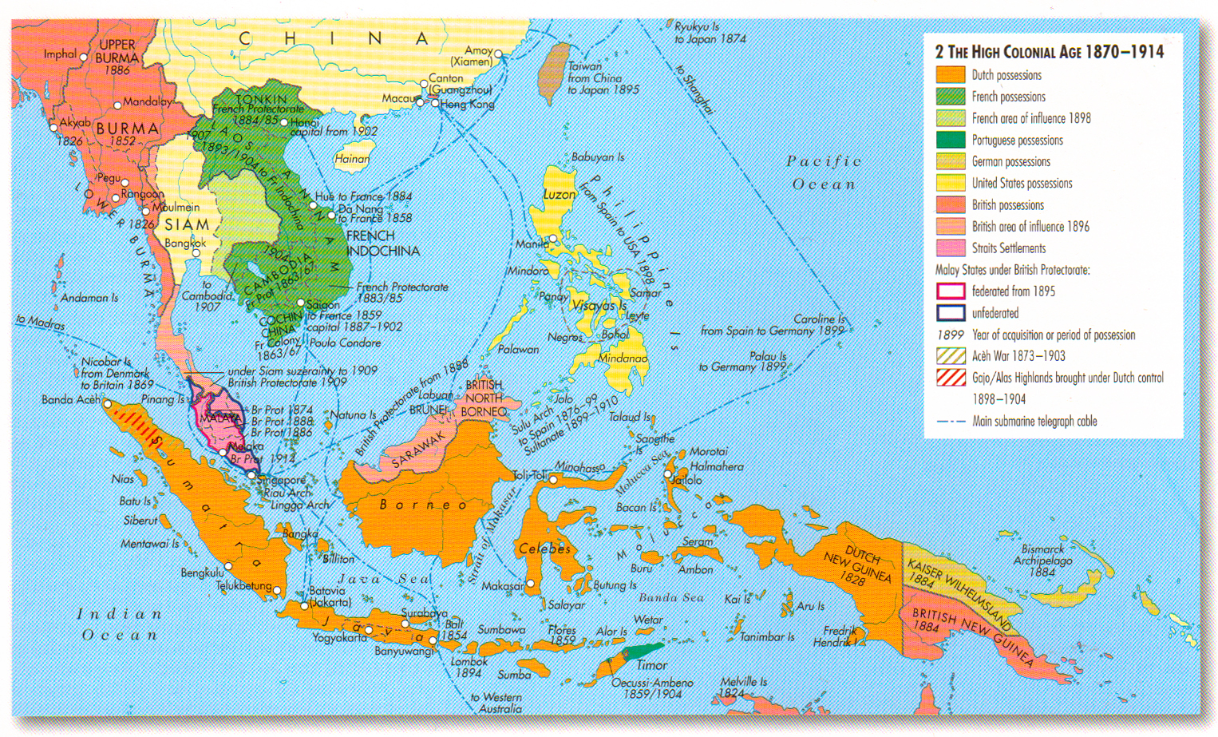
蘭
Holland
5“The High Colonial Age, 1870-1914,” Patrick O’Brian, ed. Atlas of World History, Oxford: Oxford University Press, 2nd Edition, 2010, 197.

Slide 9
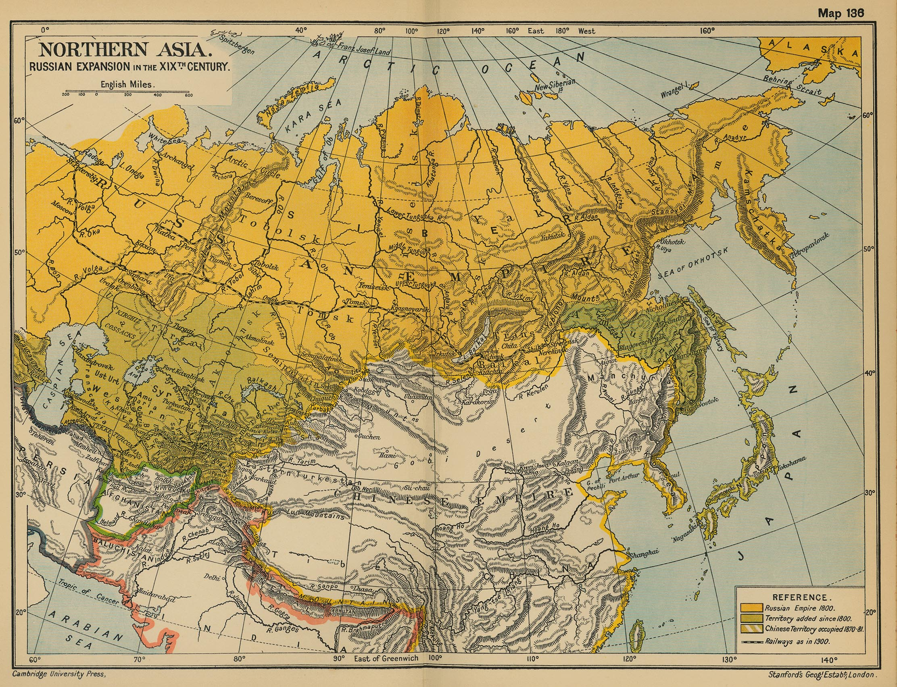
露
ソ
Russia
/ Soviet Union
3“Northern Asia: Russian Expansion in the 19th Century,” University of Cambridge Press, 1904.

Slide 10
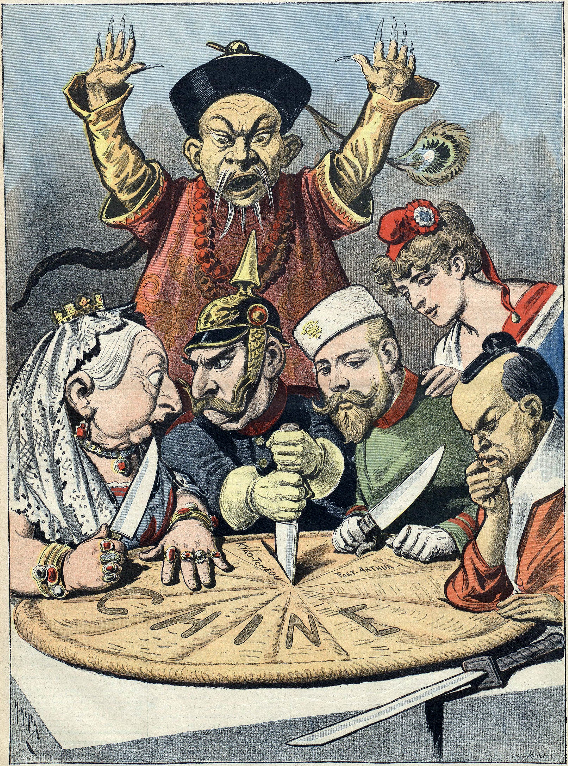
中
China
4
Henri Meyer, Untitled Illustration in Le Petit Journal, 16th January 1898.

Slide 11
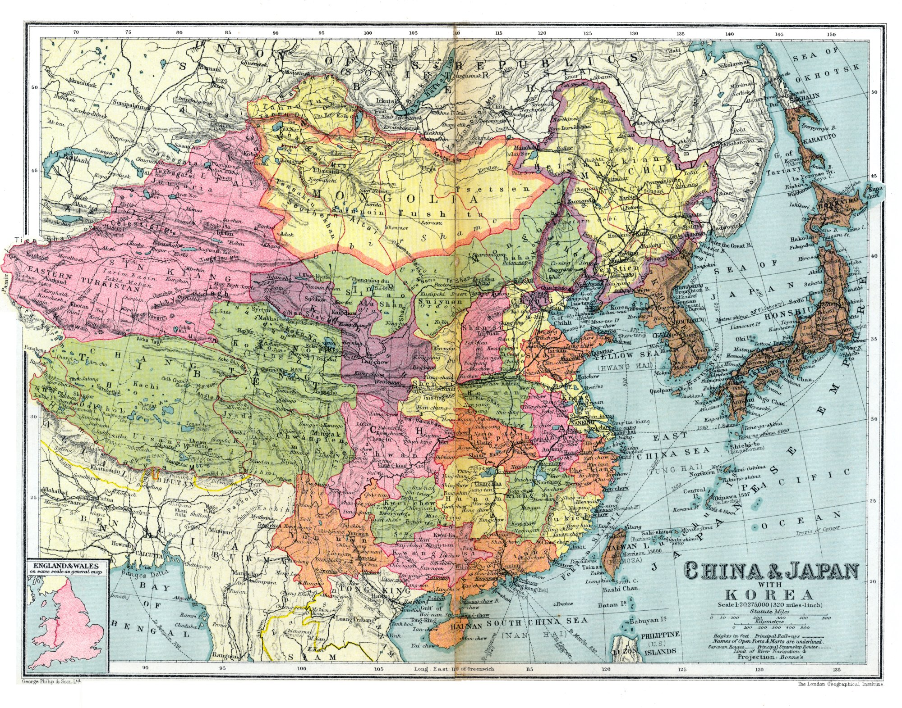
5The London Geographical Institute, “China and Japan with Korea,” 1936.

