Slide 1
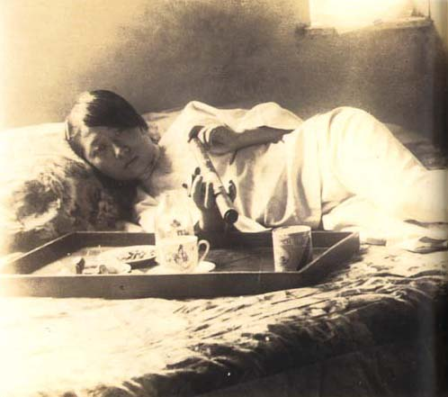
内地
Japan During WWII
HISTR 365
Joel Legassie
Nai-Chi
Vs.
外地
Gai-Chi

Slide 2
What alternatives to Expansion did Japanese state leaders have?
The Japanese Empire 1604-1945
1609 Ezo (Hokkaido), Matsumae invested as Daimyo
1609 Ryukyu Kingdom, Invaded by Satsuma Clan
1876 Korea, Treaty of Ganghwa Island
1895 China, Extraterritorial eights in Shashi (Hubei), Chongqing, Suzhou (Jiangsu), Hangzhou (Zhejiang)
1895 Taiwan, Treaty of Shimonoseki
1905 Liaodong Peninsula (Port Arthur / Dalian; Mantetsu)
1914 Shangdong Peninsula, Leased territory seized from Germany
1914 Micronesian Islands, Northern Marianas (Saipan), Caroline Islands, Marshall Islands, Seized from Germany
1931 Manchuria, Invasion from South Manchuria
1940 French Indochina, Conceded by Vichy French Government
1941 Pacific Islands, Wake Island, Guam, Gilbert Islands, (Dec. 1941), and New Britian (Rabaul), (Jan. 1942)
1942 South East Asia, Phillipines & Malaya (Jan. 1942), Singapore (Feb. 1942), Burma (March 1942), Dutch East Indies (March 1942)
1945 Surrender and loss of all Imperial Territories (Except one)

Slide 3
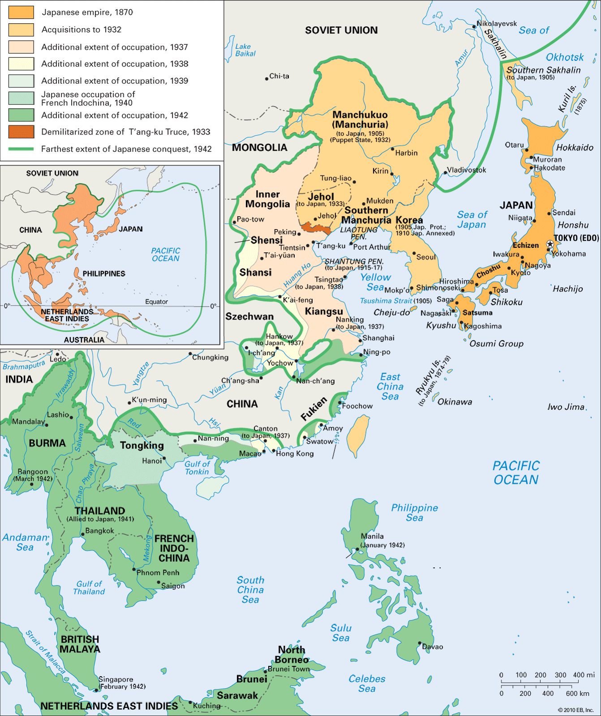
3
Japan: Japanese empire, Map/Still, from Britannica Online for Kids, accessed September 1, 2015, http://kids.britannica.com/comptons/art-166505.

Slide 4
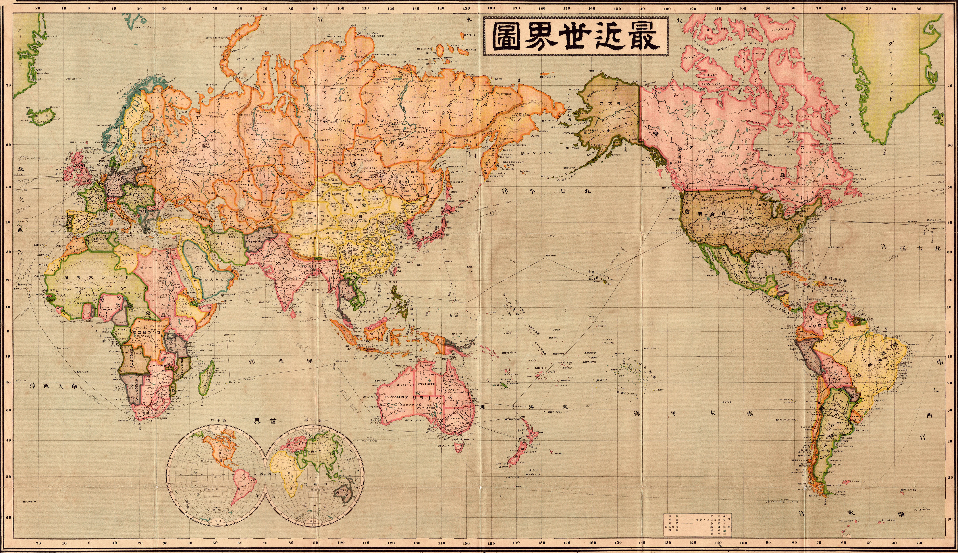
5“Saikin Sekai Zu, (Contemporary World Map),” 1914

Slide 5
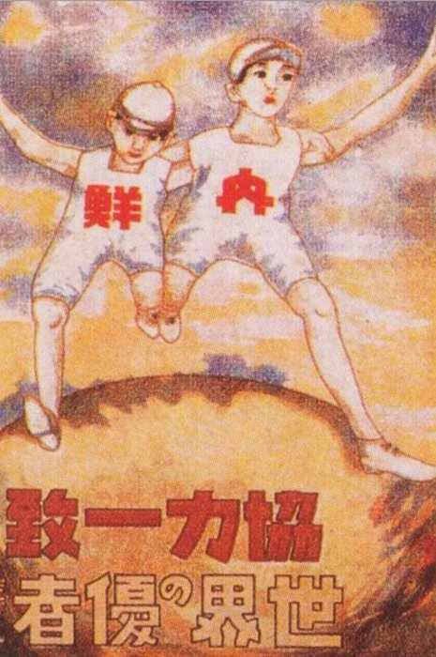
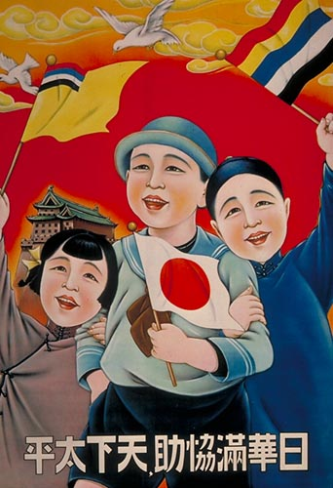
Greater East ASia
Co-Prosperity Sphere
4
Lemon A. E., “The Allied Reoccupation of the Andaman Islands, 1945,” Imperial War Museum, SE 5226.“Chinese and Malayan girls forcibly taken from Penang by the Japanese to work as 'comfort girls' for the troops.”
Promise
3
“Japan-Korea. Teamwork and Unity. Champions of the World,” c. 1936.
5Manchukuo State Council of Emperor Kang-de Puyi, “Poster of Manchukuo Promoting Harmony between Japanese, Chinese, and Manchu,” 1935.

Slide 6
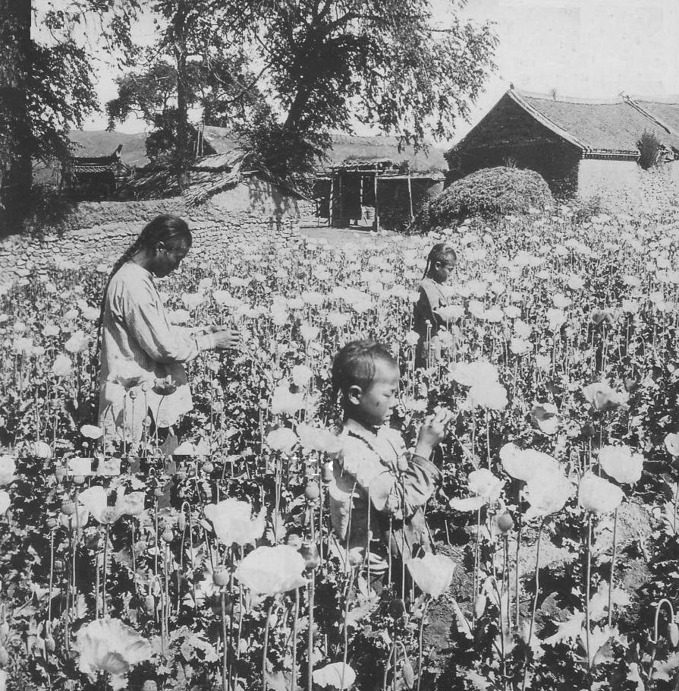
Greater East ASia
Co-Prosperity Sphere
4
Lemon A. E., “The Allied Reoccupation of the Andaman Islands, 1945,” Imperial War Museum, SE 5226.“Chinese and Malayan girls forcibly taken from Penang by the Japanese to work as 'comfort girls' for the troops.”
3
“Opium Den Hostess”, c. 1937.
Reality
4
"A Poppy field in Manchuria, Natives Extracting Fluid from which Opium is Made." Source: M.C. White Co., 1903.

Slide 7
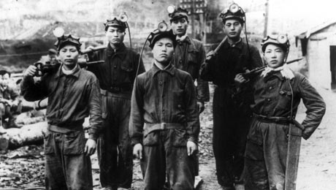
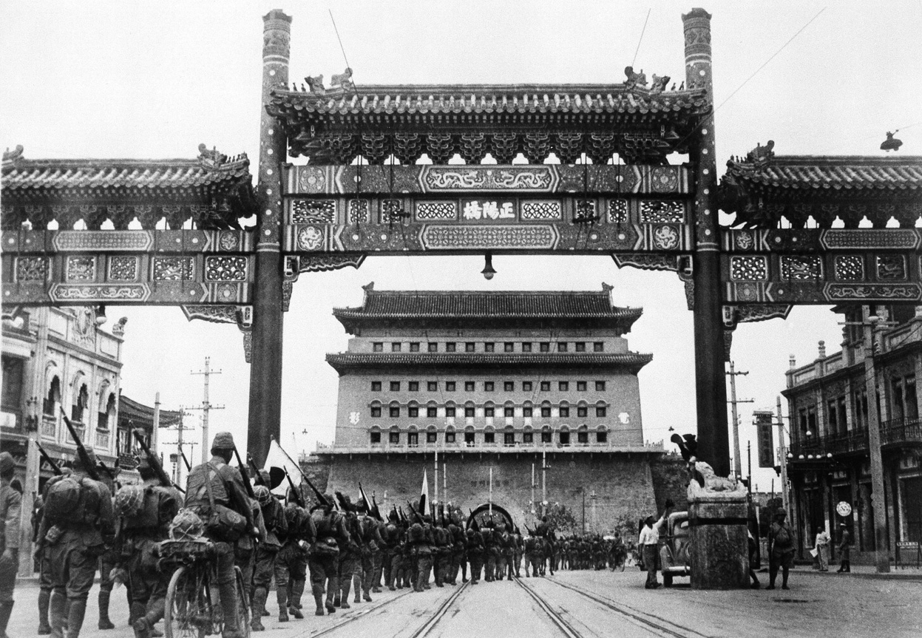
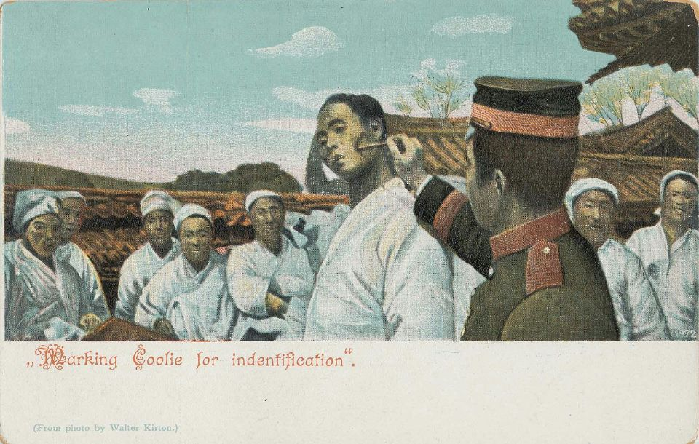
Greater East ASia
Co-Prosperity Sphere
3
Korean coalminers, Sakhalin, c. 1935.
Reality
6“Marking a Coolie for Identification,” Leonard A. Lauder Collection of Japanese Postcards at the Museum of Fine Arts, Boston, nd., no. 2002_2904.
3
Associated Press,
“First pictures of the Japanese occupation of Peiping (Beijing) in China, on August 13, 1937,” 1937.

